Slide 1
Genetic Algorithm
ESC 202

Slide 2
Agenda
Introduction
Problem
Approach
Code Implementations
Results

Slide 3
What is a Genetic Algorithm?
Fitness like in Nature
Propagation of genes
Mutation

Slide 4
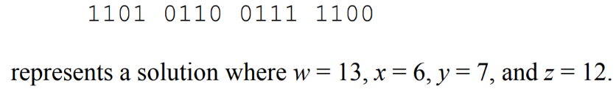
Choosing the problem to solve
Static problem
Limited number of variables
Array-like structure of bot

Slide 5
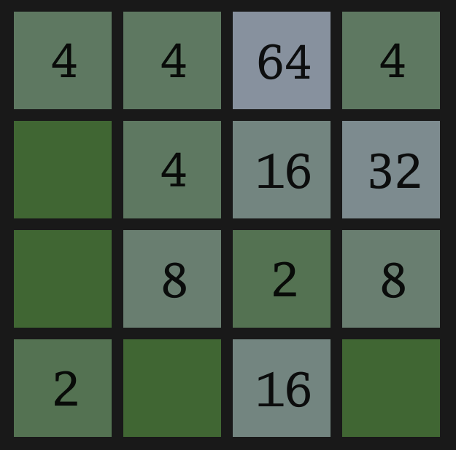
2048
Goal: Merge number blocks and try to reach 2048+
Only 4 possible moves
Relatively static
Solution can be stored in an array

Slide 6
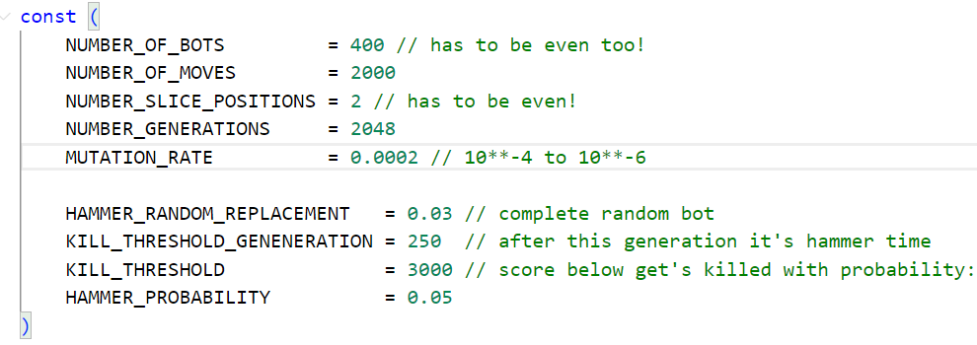
Constructor Variables

Slide 7
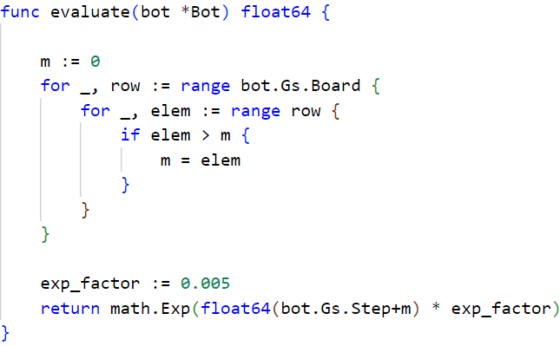
Fitness (Score)

Slide 8
Children (Next Generation of Bots)
Chosen Parents: [W, S, N, N, S, O, W, N]
[S, N, O, W, W, S, N, O]
Random Slice: [2:5]
Provisional Children: [W, S, O, W, W, S, W, N]
[S, N, N, N, S, O, N, O]
Random Mutations: [W, S, O, S, W, S, W, N]
[S, N, N, N, S, O, N, O]

Slide 9
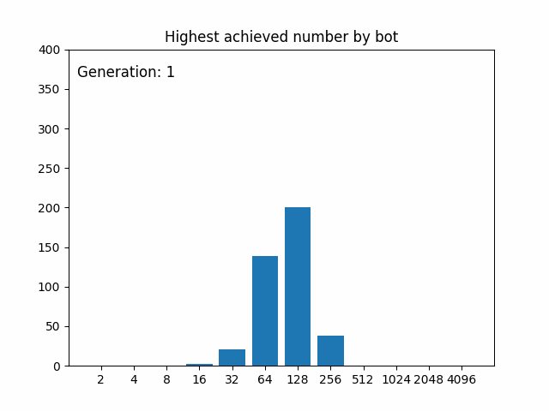
Genetic Algorithm Results
Reaches 2048 in about 1450 Generations
Still some bots reaching only low scores
~10min for 2048 Generations

Slide 10
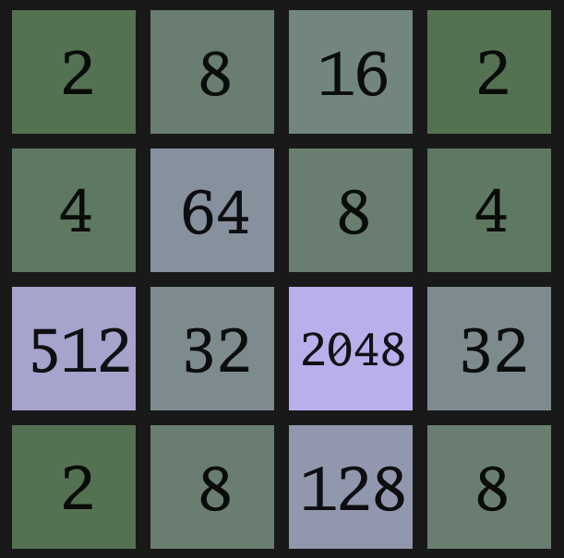
Best Bot

Slide 11
2nd Bot: Neural Network
Unconventional: Train with genetic algorithm
Input: Board is 4x4 matrix of numbers -> 16 numbers
Output: 1 of 4 directions
First Approach: One layer
Second Approach: 3 layers
Same score function for choosing next generation

Slide 12
Simple 1 Layer Architecture
Weights: W is a 4x16 matrix
Bias: b is a vector of 4 components
Feed Forward calculation:
f(x) = argmax(W x + b)
Training:
random initialization important
randomly replace weights or biases with random float

Slide 13
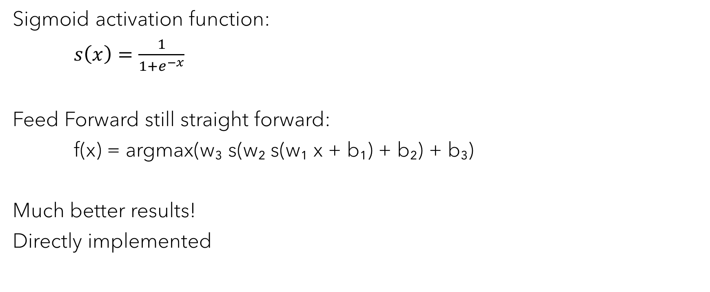
Better 3 Layer Architecture
Sigmoid activation function:
$s\left(x\right)=\frac{1}{1+e^{−x}}$
Feed Forward still straight forward:
f(x) = argmax(w₃ s(w₂ s(w₁ x + b₁) + b₂) + b₃)
Much better results!
Directly implemented

Slide 14
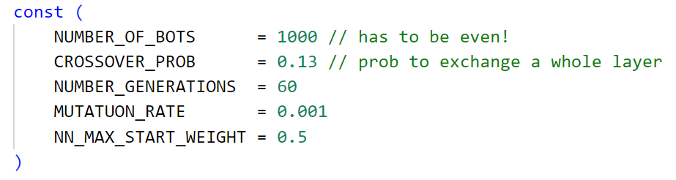
Configuration
Mutate parameters by replacing random weights, biases
Crossover Whole Layer with a probability
Random start weight have big influence on training

Slide 15
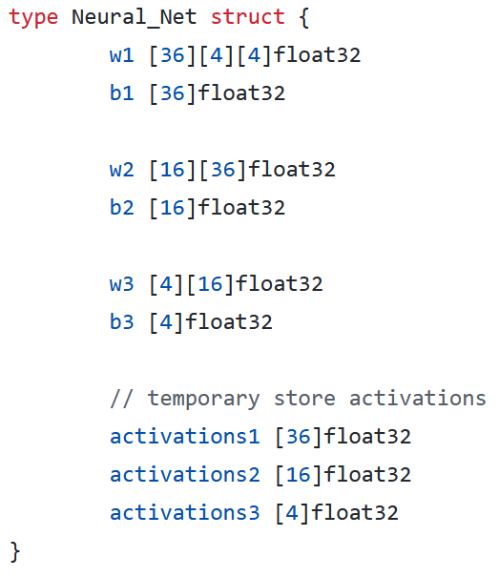
Neural Network Setup
Simple score function prefers stronger neural networks:
score = exp(0.01*max_steps)
Argmax of activations3 array gives the direction
Problem: Invalid input direction leads to infinite loop
Solution: Replace with next valid direction
North->East->South->West

Slide 16
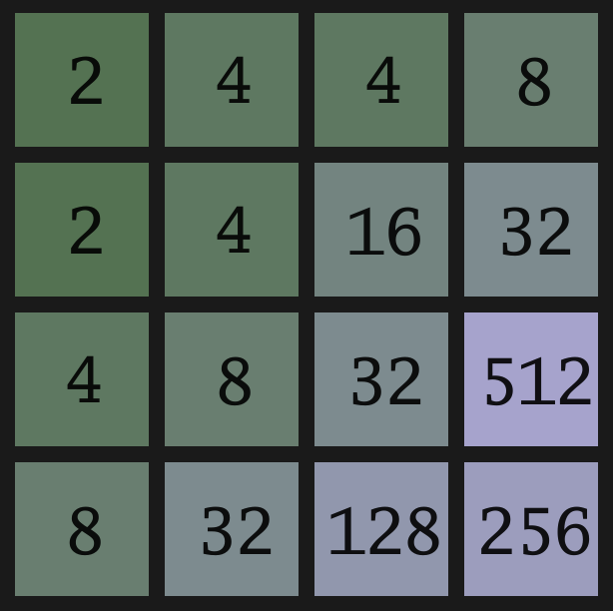
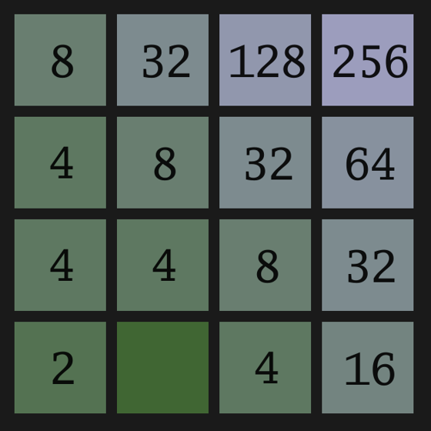
Corner Strategy

Slide 17
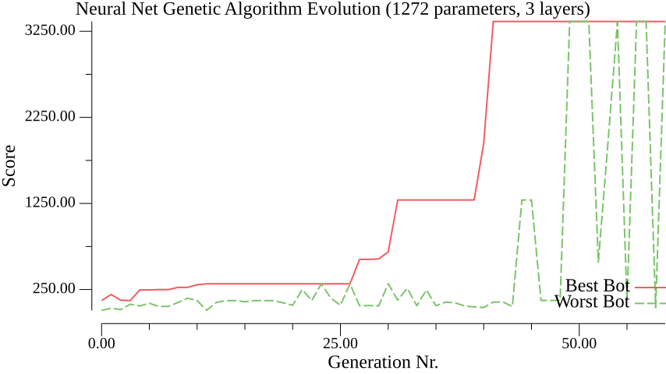
Neural Network Results
Only reached 1024 block
Genetic Algorithm not optimal for training Neural Networks
Large amount of parameters needed
More sophisticated crossover and mutation needed

Slide 18
Thank You
Project by:
Benjamin Frölich & Martin Lais

